Slide 1
Internet and Web Technology ICT- 2205 Lecture - 5
Presented By:
Mehrin Anannya
Lecturer
Institute of Information Technology
Jahangirnagar University.

Slide 2
Contents
Web Terminologies
Web Page versus Web Site
Web Site versus Web application
Web App versus Web Service
Server
Web Architecture

Slide 3
Web Page versus Web Site
A web site is a collection of web pages that are under one domain—for example, https://www.juniv.edu.
This web site has several web pages like Home, Faculties, Administration, etc.
A web page is an independent page of a web site.
Typically, a web page can be accessed by one URL in a browser and that page can be copied and or sent to a friend for review—in other words, a web page is identified by a unique URL.
Web pages can be created by user activity.

Slide 4
Web Page versus Web Site(cont.)
For example, if you visit a web search engine and enter keywords on the topic of your choice, a page will be created containing the results of your search.
When we talk about a web site, we refer to a large amount of information spread over many pages; when we talk about a web page, we are referring to a screenshot, which is a small subset of the web site and can be used for a particular purpose.

Slide 5
Web Page versus Web Site (cont.)
The difference between a web page and a web site can be summarized by these criteria:
Size: Web sites can range from very simple, single page presences to huge web sites that contain thousands of web pages. One example of a huge web site is www.facebook.com, where each member has a web page on which he makes his profile and interacts with other members. A web site can run into several pages but can be a single web page too.

Slide 6
Web Page versus Web Site (cont.)
The difference between a web page and a web site can be summarized by these criteria (cont.):
Content: The content of the web site is varied, with different web pages containing different information. Big companies may have a “Contact Us” page, a “Sign Up” page, and so on. Content on a single web page contains specific information only.
Creation: A web site is created in much the same way as a web page. After completing the web page, a navigational link is created to connect to the new page from other web pages on the web site.

Slide 7
Web Page versus Web Site (cont.)
Web sites can be further categorized as static and dynamic sites.
Static Web Sites:
A static web site is composed of web pages with content that remains constant. A static web site may consist of plain text or rich media.
However, on visiting a static site, you will see the same content at all times regardless of the time of visit.

Slide 8
Web Page versus Web Site (cont.)
Web sites can be further categorized as static and dynamic sites.
Dynamic Web Sites:
A dynamic web site updates itself frequently depending on a set of parameters.
In other words, a dynamic web site’s content is renewed every time a user visits the site.
A dynamic web page is created using a wide range of software and languages, such as JSP, ASP, PHP, Python, Perl, and so on.

Slide 9
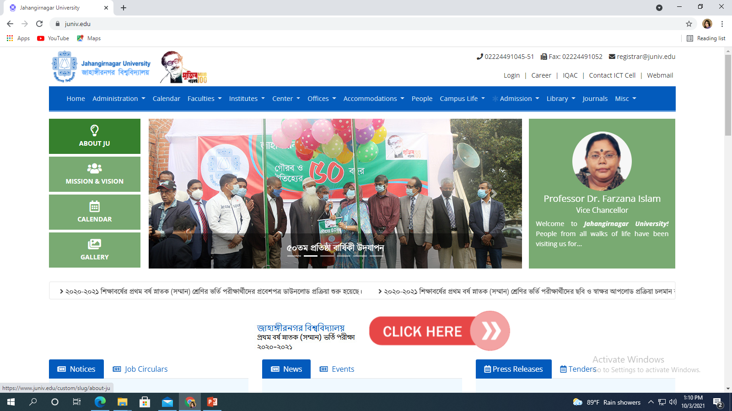
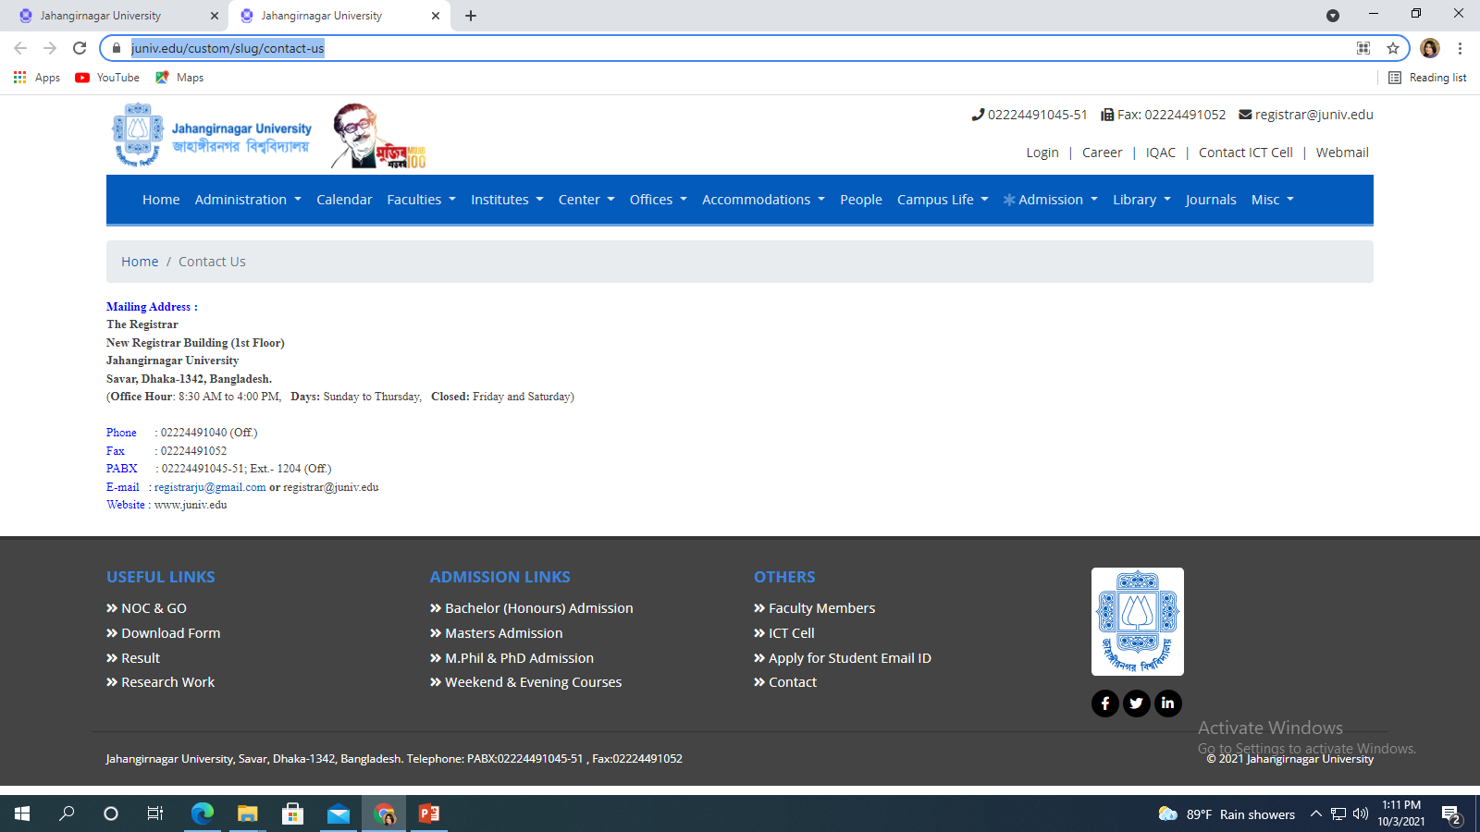
Web Page versus Web Site (cont.)
JU Web site
Contact Us page of JU Web site

Slide 10
Web Site versus Web Application
Web sites are primarily informational.
For example, http://cnn.com and http://php.net are web sites.
Web applications (or web apps), however, allow the user to perform actions.
A web app is a client-server software application for which the client (or user interface) runs in a web browser.
They actually encompass all the applications that communicate with the user via HTTP.
This includes light applications like Flash-based games, online calculators and calendars, as well as more complex applications that use HTTP.

Slide 11
Web Site versus Web Application (cont.)
Web apps are task-centric.
For example, you might use your smartphone or tablet to find an app that accomplishes a specific task, like making a call, checking your email, or finding a taxi nearby.
Web sites and web apps differ in technicalities of development.
Web apps have some defining attributes that distinguish them from web site development.

Slide 12
Web Site versus Web Application (cont.)
Web apps:
Are self-contained.
Require a rich/interactive user interface, possibly mimicking the native UI of the device.
Use advanced device capabilities like geo-location, camera integration, or other technologies developed by the W3C Device APIs and Policy Working Group.
Are action-oriented rather than information oriented.

Slide 13
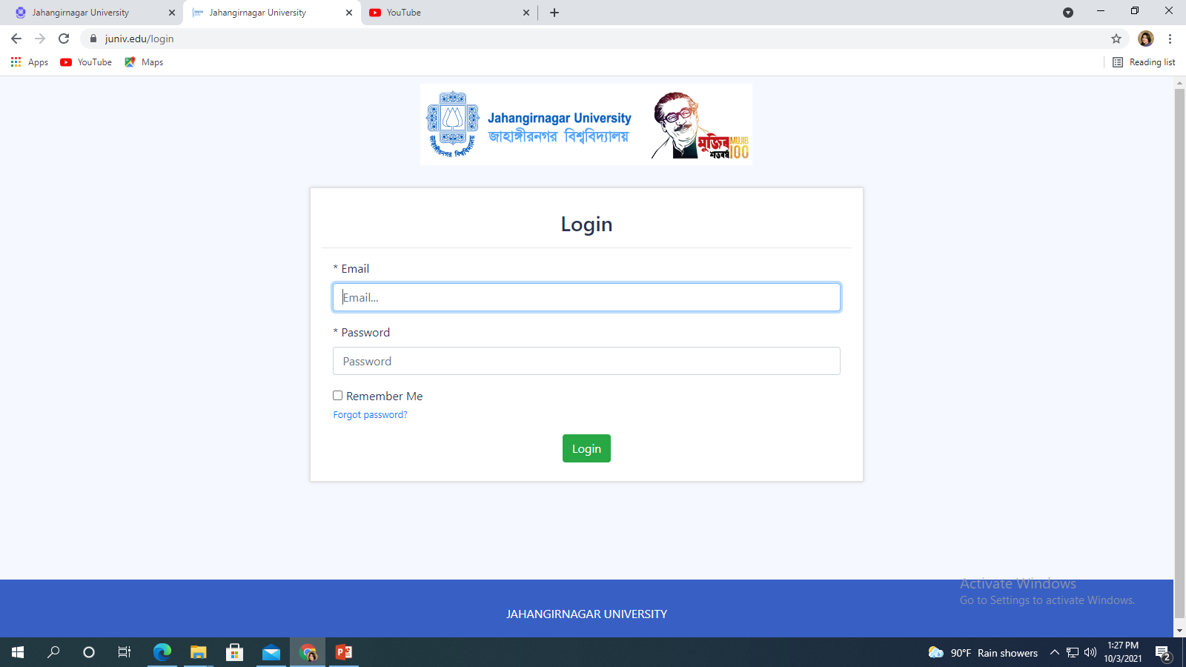
Web Site versus Web Application (cont.)
JU Web site
JU Web App

Slide 14
Web Application and Web Service
As defined by the World Wide Web Consortium (W3C), web services provide a standard means of interoperating between different software applications running on a variety of platforms and frameworks.
They are self-contained, modular, distributed, and dynamic applications that can be described, published, located, or invoked over the network to create products, processes, and supply chains.
These applications can be local, distributed, or web-based, primarily used to communicate or transfer data between web applications running on different platforms.
The basic web services platform is XML + HTTP (Extensible Markup Language + Hypertext Transfer Protocol).

Slide 15
Web Application and Web Service (cont.)
A web application is an application that is accessed through a web browser running on client machine, whereas a web service is a system of software that allows different machines to interact with each other through a network.
Web applications are intended for users and web services are intended for other applications.
A web application is typically intended for human-to-computer interaction, whereas web services are typically intended for computer-to-computer interaction.
A web service does not necessarily have a UI since it is typically used as a component in an application, while a web app is a complete application with a user interface.

Slide 16
Web Application and Web Service (cont.)
A web application can contain both a graphical user interface for human users, as well as a set of web services for computer “users” (clients).
A web site might use a web service.
A company, for example, might provide a web page with a web application and a web service—a payment service like PayPal, for instance, has both a GUI for human users and a set of web services through which back-end systems can access the PayPal services.
They are not entirely exclusive.
A university web site might have web pages that provide information such as its address, tuition rates, and academic programs.

Slide 17
Web Application and Web Service (cont.)
In addition, it will likely have web applications that let users access university mail accounts, teachers manage course materials, and students register for courses.
Meanwhile, a discussion forum is an example of a web service where an interface can be provided between a web page (for collecting data like user comments) and the backend system.

Slide 18
Server
A server is a central repository where information and computer programs are held and accessed by the programmer within the network.
It is of two types.
Web server and Application server.
Web server and Application server are kinds of the server which employed to deliver sites and therefore the latter deals with application operations performed between users and back-end business applications of the organization.

Slide 19
Web Server:
It is a computer program that accepts the request for data and sends the specified documents. Web server may be a computer where the online content is kept.
Essentially internet server is employed to host sites however there exist different web servers conjointly like recreation, storage, FTP, email, etc.
Example of Web Servers: Apache Tomcat, Resin

Slide 20
Application Server:
It encompasses Web container (implements the web component aspect of the Java engineering architecture; it specifies a run time environment for various components such as security, concurrency, transaction, and deployment) as well as EJB container(needed when data and resources are distributed across various sites).
Application servers organize the run atmosphere for enterprises applications.
Application server may be a reasonably server that mean how to put operating system, hosting the applications and services for users, IT services and organizations.
In this, user interface similarly as protocol and RPC/RMI protocols are used.
Examples of Application Server: Weblogic, Jboss, Websphere.

Slide 21
Web Architecture
The Web is a client-server system. Web browsers act as clients, making requests to web servers.
Web servers respond to requests with requested information and/or computation generated by the client.
Web applications are usually implemented with two-tier, three-tier, or multitier architectures.
Each tier is a platform (client or server) with a unique responsibility.
In two-tier client-server architecture, Tier 1 is the client platform, hosting a web browser and Tier 2 is the server platform, hosting all the server software components.

Slide 22
This architecture is inexpensive (single platform) but has limited scalability, no server redundancy, and highly interdependent components.
It is suitable for 10–100 users and non-time-critical information processing, such as for a small company or organization like a law office.
Here, server redundancy means that if a primary server is unavailable due to a power outage, network connection loss, or other failure, a designated backup system takes over and enables the application to continue running.
Backup servers behave as clients until their designated primary system fails.
If the primary server fails, the first system designated as a backup server immediately takes over the primary server’s role, enabling the application to continue running until the primary server is back online.

Slide 23
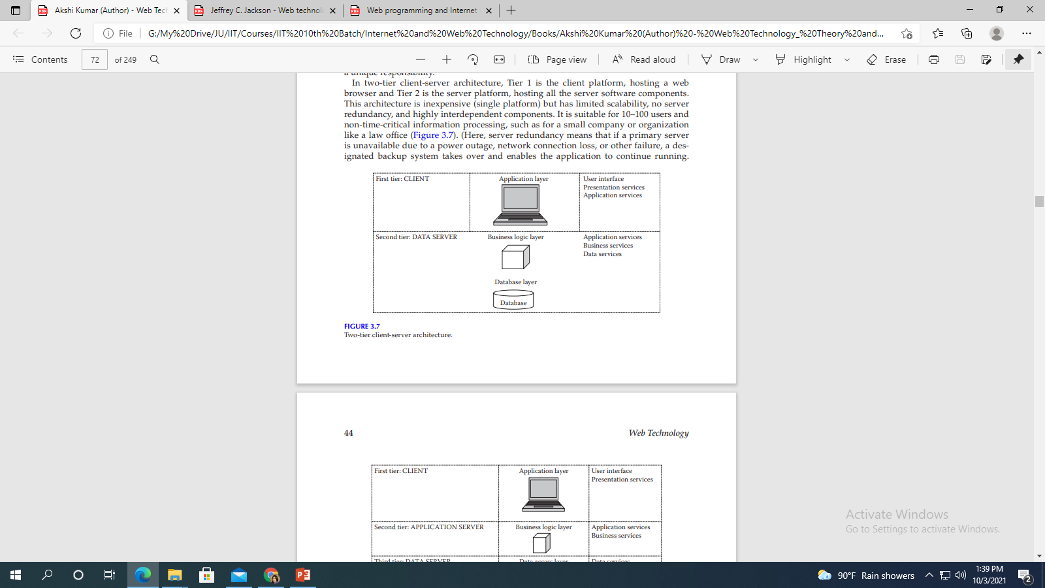
Web Architecture(cont.)
Two-tier client-server architecture.

Slide 24
Web Architecture(cont.)
In three-tier architecture, Tier 3 takes over part of the server function from Tier 2—typically data management.
This architecture provides improved performance (from specialized hardware), has decreased coupling of software components, and offers improved scalability.
But it, too, has no server redundancy.
A typical application that involves a three-tier architecture might be a regional organization, such as a college.
The three-tier structure can be extended to N-tier, containing several special application servers.

Slide 25
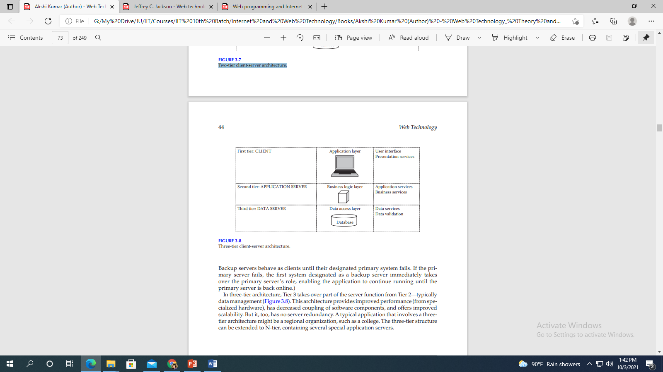
Web Architecture(cont.)
Three-tier client-server architecture

